Slide 1
Celebrations
12. WH questions, past and present

Slide 2
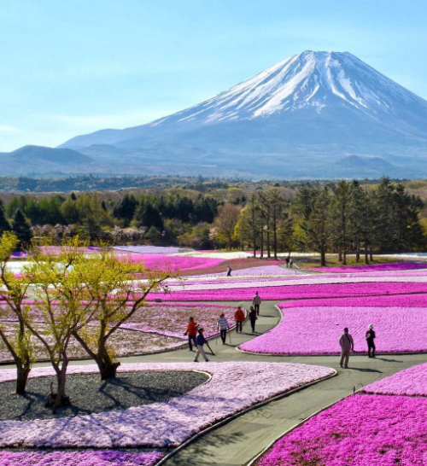
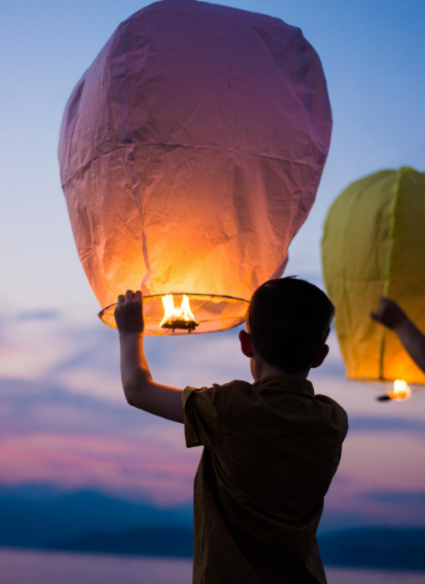
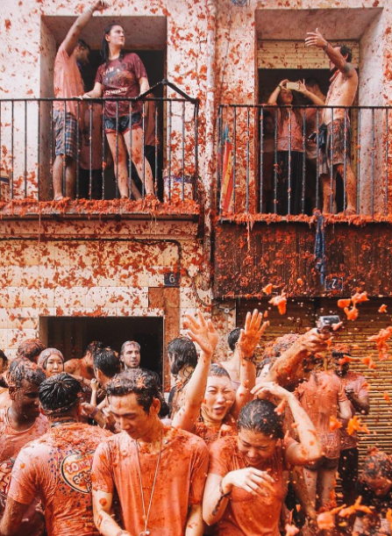
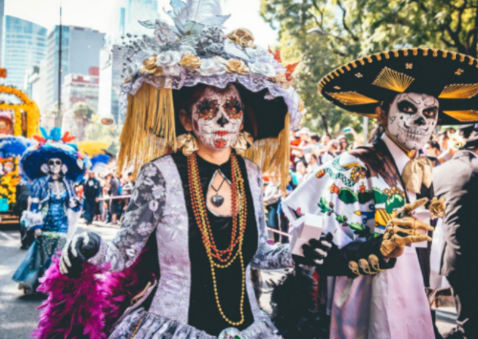
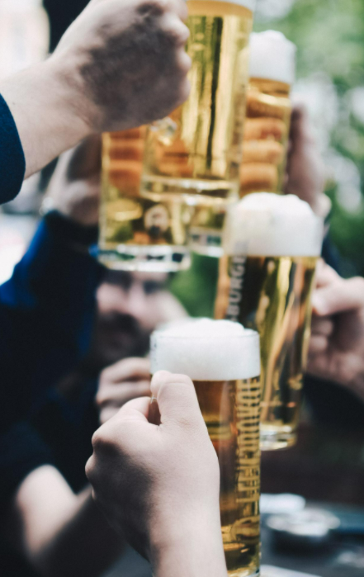
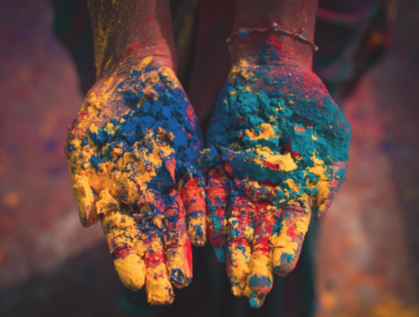
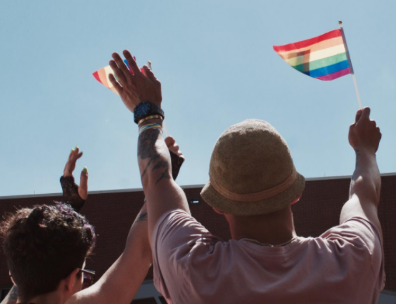
Celebrations
What do you celebrate every year?
When do you celebrate those holidays?
How did you celebrate last year’s holidays?
What did you do during those days?

Slide 3
Wh questions
What | General | What are you doing?
When | Time | When do you go to the bakery?
Where | Place | Where do you work?
Why | Reason | Why are you drinking coffee?
Who | People | Who is your manager?
Which | Choices | Which shift do you prefer?
How | Method, condition | How do you schedule a meeting?

Slide 4
Choose the correct WH question
_____ is the concert?
_____ is Cristiano Ronaldo from?
_____ were you so happy?
_____ is your brother?
_____ were you late?
_____ one is correct?
_____ is my computer?
_____ was the problem?
_____ is your birthday?
_____ old are you?
_____ is your email?
_____was your best friend?
_____ are you?
_____ do you have vacations?
_____ old is your pet?
_____ one is yours?
Notes:
When/where
Where
Why
Who
Why
Which
Where
What/Where
When
How
What
Who
How
When/Where/why
How
Which

Slide 5
Present simple vs continuous
Present Simple | Present Continuous
I / You / We / They eat every day. He / She / It eats every day | I am eating now. He / She / It is eating now. You / We / They are eating now
Time Expressions | Time Expressions
every day / year / Sunday; once / twice a week, always, never, often, seldom, rarely, usually, frequently, hardly ever, sometimes, these days, nowadays | now, right now, at the moment, today
Give some examples with each.

Slide 6
Simple or continuous
I celebrate / am celebrating my birthday every year.
My mom bakes / is baking a cake every Christmas.
He works / is working right now. Please, don’t disturb him.
My friends and I always text / are texting each other in the morning.
Julia leaves / is leaving now. Her uber is outside.
Mexico has / is having a Day of the Death celebration every November.
People make / is making a barbeque every year on July 4th.
Many people visit / are visiting their families to celebrate the New Year.
Notes:
What question would you use to answer it.
Celebrate
bakes
Is working
Text
Is leaving
Has
Make
Visit

Slide 7
Past simple vs past continuous
Past Simple | Past Continuous
I / You / He / She / It / We / You / They ate last night | I / He / She / It was eating all day. You / We / They were eating all day.
Time Expressions | Time Expressions
yesterday, a week ago, two years ago last month / last Friday in those days, in the past | while, as the whole day / evening / morning (in the past) all day (in the past)
Give some examples with each.

Slide 8
Complete the sentences
I _______ a wedding last month, and it was beautiful. |  | dressed up
While we were _______, the DJ was playing our favorite songs. |  | chatted
We _______ the house for the anniversary party. |  | cheering
Last Halloween, I _______ as Loki. |  | decorated
The host was _______ a speech while we listened attentively. |  | exchanged
We _______ gifts and shared stories. |  | dancing
While the crowd was _______, the team scored a goal. |  | attended
The family _______ while I was preparing appetizers. |  | giving
Notes:
I attended a wedding last month, and it was beautiful.
While we were dancing, the DJ was playing our favorite songs.
We decorated the house for the anniversary party.
Last Halloween, I dressed up as Loki.
The host was giving a speech while we listened attentively.
We exchanged gifts and shared stories.
While the crowd was cheering, the team scored a goal.
The family chatted while I was preparing appetizers.

Slide 9
Choose the correct tense
Larry was at a Halloween party. While he is talking / was talking / talked / talks to Jessie, his beard fell into his drink.
Right now someone knocks / knocked / is knocking / was knocking on the door. Is someone answering it?
Kate and Margie usually wear / were wearing / are wearing / wears very creative costumes.
I buy / am buying / was buying / bought a great Halloween costume last week.
Bernie is going / was going / goes / go to the Halloween party as a wizard every year.
Is the judge announcing / announce / announces / announced the best costume now?
Colleen was meeting / meets / met / is meeting Harold at a Halloween party two years ago.
Who are you seeing / did you see / do you see / were you seeing at the Halloween party yesterday?
While Fred is trying on / tried on / tries on / was trying on his boots and cape last night, Katie and Patricia were making their hats and wands.
Lance isn’t wearing / doesn’t wear / wasn’t wearing / didn’t wear his pirate costume at the moment. He is carrying it in his hands.
Notes:
1. was talking
2. is knocking
3. wear
4. bought
5. goes
6. announcing
7. met
8. did you see
9. was trying on
10. isn’t wearing

Slide 10
Either and Neither
We use either with negative sentences and comes at the end of the sentence, and we use neither with affirmative sentences and comes first.
I don’t celebrate my birthday. What about you?
I do not celebrate it either. (Me either)
Neither do I. (Me neither)
We use either + or to talk about 2 viable options.
I want either vanilla or chocolate cake. (both options are great)
We use neither + nor to talk about 2 nonviable options.
I want neither icecream nor cheesecake. (both options are awful)
Notes:
Me either and me neither are very informal, and should not be used in formal writing.
Either on its own means any of two options.
Neither in its own none of the two options.
We can’t use either nor neither when there are more tan 2 options. In that case use any or none.
Too or as well can’t be used in negative sentences.
https://www.gymglish.com/es/gymglish/gramatica-inglesa/either-neither

Slide 11
Choose the correct one
Unfortunately, ______ John nor Sarah can attend engagement celebration due to prior commitments.
______ my sister or I will be in charge of organizing the party.
A: I don’t want to go. B: I don’t want to go ______.
______ the weather nor the logistics favored an outdoor celebration.
You can ______ bring your favorite dish or buy something for the potluck.
______ the proposed venues were suitable for the grand celebration we had in mind. Both were awful.
We could find ______ the desired decorations nor the appropriate gifts for the celebration
______ of the options for the graduation celebration seem appealing to the graduates. They are happy with both options.
Due to unforeseen circumstances, ______ the cake nor the party favors arrived on time.
A: I couldn’t buy appropriate decorations. B: ______ could I.
Notes:
Unfortunately, neither John nor Sarah can attend engagement celebration due to prior commitments.
Either my sister or I will be in charge of organizing the party.
A: I don’t want to go. B: I don’t want to go either.
Neither the weather nor the logistics favored an outdoor celebration.
You can either bring your favorite dish or buy something for the potluck.
Neither the proposed venues were suitable for the grand celebration we had in mind.
We could find neither the desired decorations nor the appropriate gifts for the celebration
Either of the options for the graduation celebration seems appealing to the graduates.
Due to unforeseen circumstances, neither the cake nor the party favors arrived on time.
A: I couldn’t buy appropriate decorations. B: Neither could I.

Slide 12
Talk about a celebration
Tell your friends about your favorite celebration.
Ask your friend about theirs:
where the celebration was
what kind of a celebration it was
what costume they wore, if any
what food and music they enjoyed
if they had a good time

